Slide 1




GRADE 11 · ALGEBRA II · TOPIC 6
Lesson 6-7
Geometric Sequences
and Series
Journey of 6 stations, 60 minutes
Exponential and Logarithmic Functions
Mr Malek Thiab
FAITH, RIGHTEOUSNESS AND WISDOM
Notes:
Speaker notes: Welcome to Lesson 6-7: Geometric Sequences and Series.
Timing: 60 minutes (Diagnose 6, Targeted Instruction 18, Practice 12, Production 12, Mastery Gate 6, Smart Production 6). For a 40-minute class scale every station by two thirds.
The journey map on the next slide shows the six stations; in slideshow mode the Morph transition zooms the station circles into the breadcrumb at the top of every later slide.

Slide 2


Today's journey
Six stations. Each one zooms in as we arrive.
Targeted Instruction
18 min
Production
12 min
Smart Production
6 min
2
4
6
1
3
5
Diagnose
6 min
Practice
12 min
Mastery Gate
6 min
FAITH, RIGHTEOUSNESS AND WISDOM
Notes:
Speaker notes: This is the whole map. Walk it left to right: Diagnose (what we already know), Targeted Instruction (Identify a geometric sequence; Recursive and explicit formulas; Geometric series, sigma notation and the sum formula; Use the formula to find sums), Practice (Practice, Apply, Investigate), Production (Jeddah greening programme), Mastery Gate (three questions to pass), Smart Production (create, then Time to Check).
In slideshow mode the Morph transition animates these circles shrinking into the breadcrumb on later slides; without Morph the slides fade.
Ask the class which station they think will be hardest.

Slide 3
What we are learning
OBJECTIVES
VOCABULARY
Identify geometric sequences.
Write recursive and explicit formulas for geometric sequences.
Identify geometric series.
Derive the formula for geometric series.
Use the formula for geometric series to find sums.
common ratio
ending index
geometric sequence
geometric series
Index
sequence of partial sums
sigma notation
starting index
summand
terms
STANDARDS
HSA.SSE.B.4 Derive the formula for the sum of a finite geometric series (when the common ratio is not 1), and use the formula to solve problems.
HSF.IF.A.3 Recognize that sequences are functions, sometimes defined recursively, whose domain is a subset of the integers.
HSF.BF.A.2 Write arithmetic and geometric sequences both recursively and with an explicit formula, use them to model situations, and translate between the two forms.
HSF.LE.A.2 Construct linear and exponential functions, including arithmetic and geometric sequences, given a graph, a description of a relationship, or two input-output pairs
ESSENTIAL QUESTION
How can we use geometric sequences to model real-world situations?
MATHEMATICAL PRACTICES MP.4 · MP.7
HSA.SSE.B.4 · HSF.IF.A.3 · HSF.BF.A.2 · HSF.LE.A.2
FAITH, RIGHTEOUSNESS AND WISDOM
Mr Malek Thiab · 3
Notes:
Speaker notes: Read the objectives aloud one at a time and have students say which one they feel least sure about.
Vocabulary used today: common ratio, ending index, geometric sequence, geometric series, Index, sequence of partial sums, sigma notation, starting index, summand, terms.
Standards are listed on this slide.

Slide 4

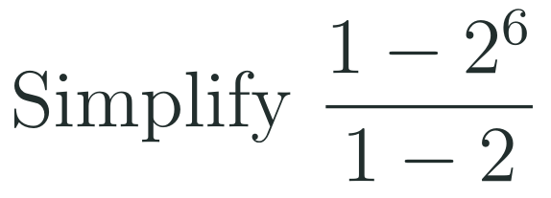

1
2
3
4
5
6
STATION 1 · DIAGNOSE · 6 MIN
Start here: three quick checks
1
2
3
Done when
All three answers are written without a calculator, and you can say which operation repeats in the third list.
HSA.SSE.B.4 · HSF.IF.A.3 · HSF.BF.A.2 · HSF.LE.A.2
FAITH, RIGHTEOUSNESS AND WISDOM
Mr Malek Thiab · 4
Notes:
Speaker notes (Diagnose, 6 min, no calculator):
Answers. Q1: 3^4 = 81 first (order of operations), then 5 x 81 = 405. Q2: 2^6 = 64, so (1 - 64)/(1 - 2) = (-63)/(-1) = 63. Q3: arithmetic sequence (Lesson 1-4 recall), common difference d = 4, a_n = 7 + 4(n - 1), so a_10 = 7 + 36 = 43. Verbal misconceptions: Q1 computing (5 x 3)^4 = 50 625 (power applied to the product); Q2 'the 1s cancel' giving 2^6/2 = 32, or a sign slip giving -63; Q3 using 7 + 4 x 10 = 47 (n instead of n - 1). Adaptive routing: if >30% miss Q1, spend 2 minutes on powers before slide 6 (explicit formulas use a_1 times r to a power); if >30% miss Q2, flag it and slow down on slide 7 and slide 8 (the sum formula has exactly this shape); if >30% miss Q3, go to slide 5 and contrast 'add the same number' with 'multiply by the same number' before the first example. If 90% get all three, move quickly through slide 5.

Slide 5


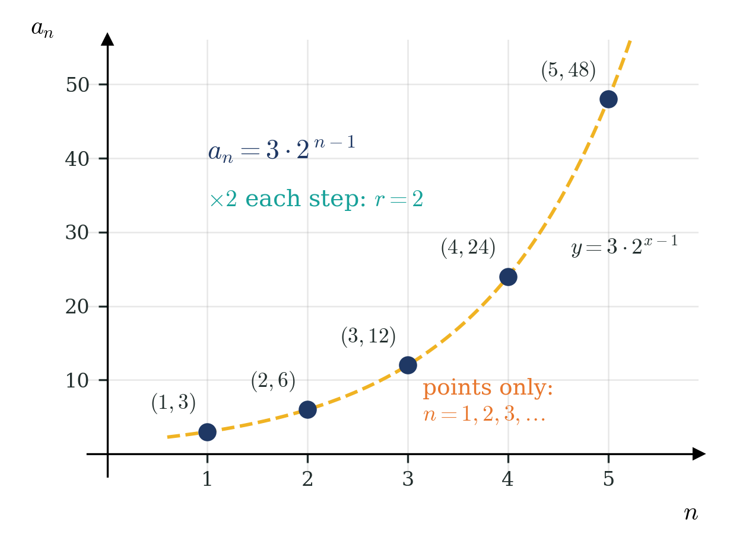

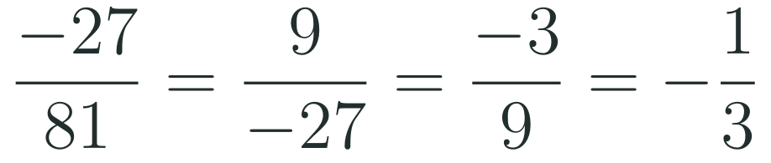
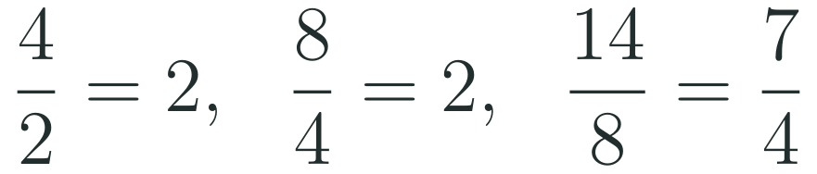
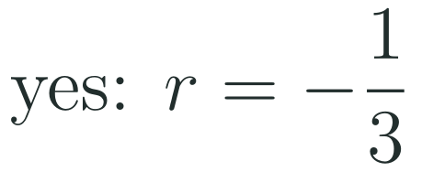
1
2
3
4
5
6
STATION 2 · TARGETED INSTRUCTION · 18 MIN
Identify a geometric sequence
EXAMPLE A
EXAMPLE B
HSA.SSE.B.4 · HSF.IF.A.3 · HSF.BF.A.2 · HSF.LE.A.2
FAITH, RIGHTEOUSNESS AND WISDOM
Mr Malek Thiab · 5
Notes:
Speaker notes (Targeted Instruction, block 1 of 4):
Worked solutions. A geometric sequence multiplies by the same number, the common ratio r, to get from each term to the next. Test it by dividing each term by the term before it. Example A: -27/81 = -1/3, 9/(-27) = -1/3, -3/9 = -1/3, so it is geometric with r = -1/3; the next term is -3 x (-1/3) = 1. A negative ratio makes the signs alternate. Example B: 4/2 = 2 and 8/4 = 2 but 14/8 = 7/4, so it is NOT geometric (one ratio is enough to fail). The graph: a_n = 3 x 2^(n-1) gives the terms 3, 6, 12, 24, 48. A sequence is a function whose domain is n = 1, 2, 3, ... (HSF.IF.A.3), so its graph is separate POINTS, not a curve. The dashed curve y = 3 x 2^(x-1) is the exponential function through those points: a geometric sequence is an exponential function on the integers (HSF.LE.A.2). Verbal misconceptions: subtracting terms to find r (that gives a common difference, so the sequence is arithmetic); dividing the wrong way round (81/(-27) = -3 instead of -1/3); 'the first two ratios match, so it is geometric'; joining the points of a sequence with a solid line. Adaptive routing: if >30% subtract instead of divide, return to Diagnose Q3 (slide 4) and set 7, 11, 15 beside 3, 6, 12; if >30% miss Example A, redo with 64, -32, 16, -8 (r = -1/2). Gate Q1 routes back to this slide (slide 5).

Slide 6


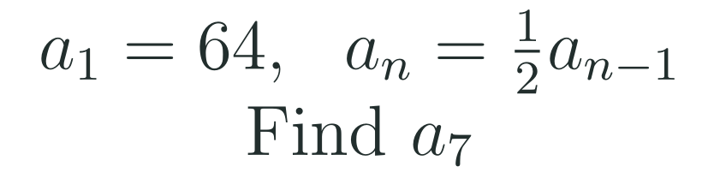

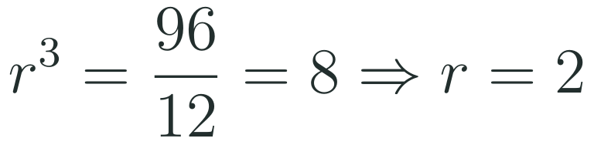
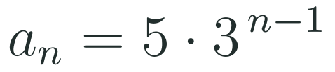
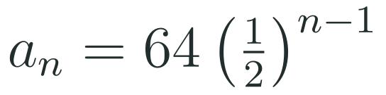
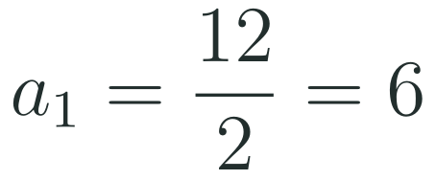
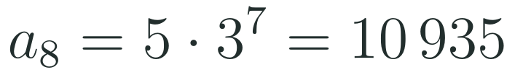
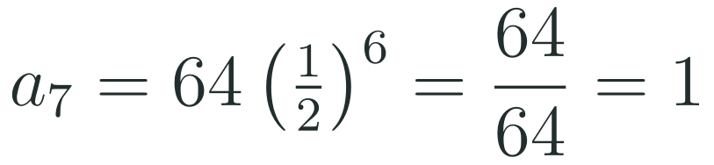
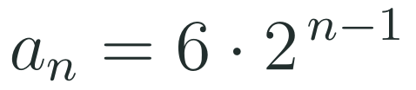
1
2
3
4
5
6
STATION 2 · TARGETED INSTRUCTION · 18 MIN
Recursive and explicit formulas
EXAMPLE A
EXAMPLE B
EXAMPLE C
HSA.SSE.B.4 · HSF.IF.A.3 · HSF.BF.A.2 · HSF.LE.A.2
FAITH, RIGHTEOUSNESS AND WISDOM
Mr Malek Thiab · 6
Notes:
Speaker notes (Targeted Instruction, block 2 of 4):
Worked solutions. Recursive form says how to get the next term from the one before (start value plus rule); explicit form gives any term directly from n (HSF.BF.A.2: translate between the two). Example A: a_1 = 5 and r = 15/5 = 3. Recursive: a_1 = 5, a_n = 3a_(n-1). Explicit: a_n = 5 x 3^(n-1). a_8 = 5 x 3^7 = 5 x 2187 = 10 935. Check with the recursive rule: 5, 15, 45, 135, 405, 1215, 3645, 10 935 (8th term). Example B (two input-output pairs, HSF.LE.A.2): going from term 2 to term 5 is 3 multiplications, so r^3 = 96/12 = 8 and r = 2. Then a_1 = a_2 / r = 12/2 = 6, so a_n = 6 x 2^(n-1). Check: a_5 = 6 x 16 = 96. Example C: recursive to explicit: a_n = 64 (1/2)^(n-1); a_7 = 64 x (1/2)^6 = 64/64 = 1. Check: 64, 32, 16, 8, 4, 2, 1. Verbal misconceptions: using r^n instead of r^(n-1) (a_8 = 5 x 3^8 = 32 805, off by one factor); writing r^4 = 8 in Example B (counting terms instead of steps: 5 - 2 = 3 steps); computing 5 x 3^7 as 15^7; dividing a_2 by r twice. Adaptive routing: if >30% use r^n, list the first three terms of Example A against the formula on the board; if >30% miss Example B, draw the four positions 2, 3, 4, 5 with x r arrows between them; if Diagnose Q1 was weak, model 5 x 3^7 slowly. Gate Q2 routes back to this slide (slide 6).

Slide 7



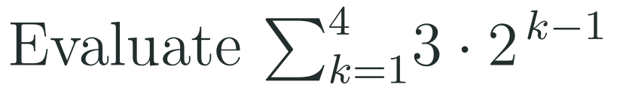
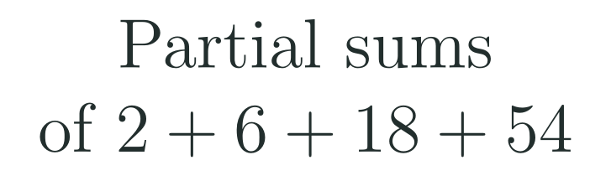



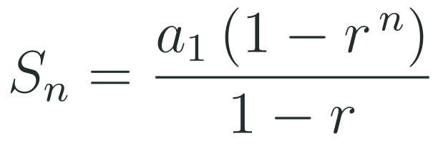
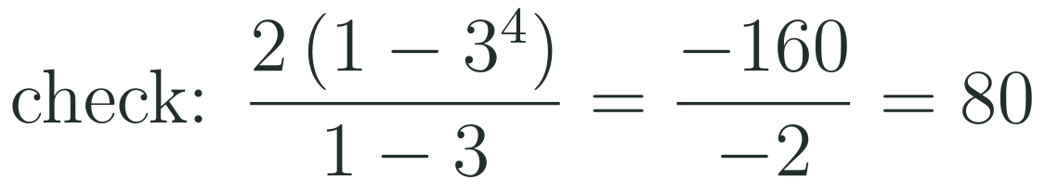
1
2
3
4
5
6
STATION 2 · TARGETED INSTRUCTION · 18 MIN
Geometric series, sigma notation and the sum formula
EXAMPLE A
EXAMPLE B
EXAMPLE C
HSA.SSE.B.4 · HSF.IF.A.3 · HSF.BF.A.2 · HSF.LE.A.2
FAITH, RIGHTEOUSNESS AND WISDOM
Mr Malek Thiab · 7
Notes:
Speaker notes (Targeted Instruction, block 3 of 4):
Worked solutions. A geometric series is the SUM of the terms of a geometric sequence. Sigma notation: the starting index (k = 1) is under the sigma, the ending index (n) is on top, and the summand (a_1 r^(k-1)) is the expression we add for each index value. Example A (derivation, HSA.SSE.B.4): write S_n = a_1 + a_1 r + a_1 r^2 + ... + a_1 r^(n-1). Multiply every term by r: r S_n = a_1 r + a_1 r^2 + ... + a_1 r^n. Subtract the second line from the first: every middle term cancels, leaving S_n - r S_n = a_1 - a_1 r^n. Factor: S_n (1 - r) = a_1 (1 - r^n). Divide by (1 - r), allowed only when r is not 1: S_n = a_1 (1 - r^n)/(1 - r). Example B: k = 1, 2, 3, 4 gives 3 x 1, 3 x 2, 3 x 4, 3 x 8 = 3 + 6 + 12 + 24 = 45. Check with the formula: 3(1 - 16)/(1 - 2) = (-45)/(-1) = 45. Example C: the sequence of partial sums is S_1 = 2, S_2 = 2 + 6 = 8, S_3 = 8 + 18 = 26, S_4 = 26 + 54 = 80; formula with a_1 = 2, r = 3, n = 4: 2(1 - 81)/(1 - 3) = (-160)/(-2) = 80. Verbal misconceptions: 'the series is the list of terms' (a series is a sum); starting the index at k = 0 and getting an extra term; writing the last term as a_1 r^n instead of a_1 r^(n-1); in the subtraction, cancelling the first term a_1 by mistake; dividing by 1 - r when r = 1. Adaptive routing: if >30% cannot follow the subtraction, write the two lines one under the other with the matching terms in the same column and cross them out in colour; if >30% miss Example B, list k = 1 to 4 in a table with the summand value in a second column. Gate Q3 routes back to this slide (slide 7) together with slide 8.

Slide 8


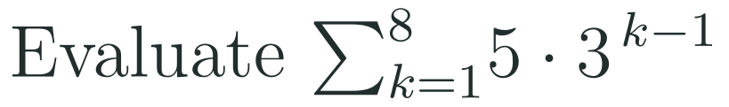

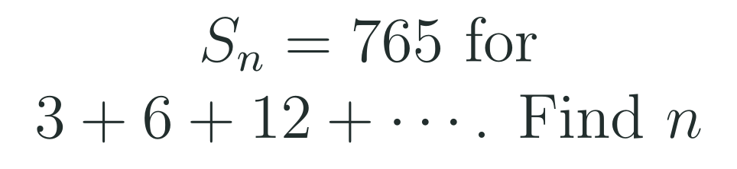


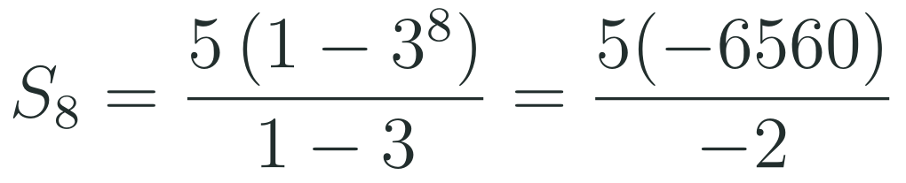
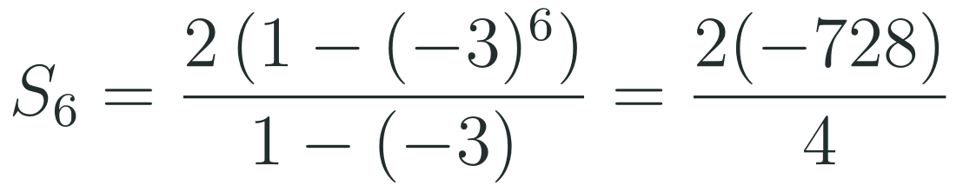
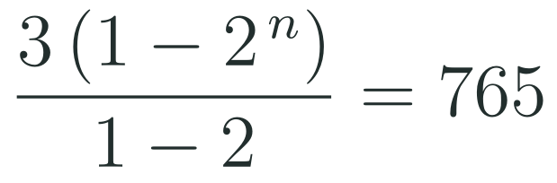



1
2
3
4
5
6
STATION 2 · TARGETED INSTRUCTION · 18 MIN
Use the formula to find sums
EXAMPLE A
EXAMPLE B
EXAMPLE C
HSA.SSE.B.4 · HSF.IF.A.3 · HSF.BF.A.2 · HSF.LE.A.2
FAITH, RIGHTEOUSNESS AND WISDOM
Mr Malek Thiab · 8
Notes:
Speaker notes (Targeted Instruction, block 4 of 4):
Worked solutions. Always name a_1, r and n first. Example A: a_1 = 5, r = 3, n = 8; 3^8 = 6561; S_8 = 5(1 - 6561)/(1 - 3) = 5(-6560)/(-2) = 5 x 3280 = 16 400. Example B: a_1 = 2, r = -6/2 = -3, n = 6; (-3)^6 = 729 (even power, positive); S_6 = 2(1 - 729)/(1 + 3) = 2(-728)/4 = -364. Check by adding: 2 - 6 + 18 - 54 + 162 - 486 = -364. Example C: a_1 = 3, r = 2, so S_n = 3(1 - 2^n)/(1 - 2) = 3(2^n - 1) = 765; 2^n - 1 = 255, 2^n = 256 = 2^8, n = 8 terms (a common-base equation from Lesson 6-6). Check: the 8th term is 3 x 2^7 = 384 and 3 + 6 + 12 + 24 + 48 + 96 + 192 + 384 = 765. When r = 1 every term is a_1, so S_n = n a_1 (the formula would divide by 0). Verbal misconceptions: using r = 3 instead of r = -3 in Example B (sign error, giving 728); writing (-3)^6 = -729; writing 1 - (-3) = -2 in the denominator; answering a_8 = 10 935 when the question asks for the sum; in Example C setting the last term equal to 765. Adaptive routing: if >30% miss Example B, add the six terms by hand first, then match the formula; if >30% miss Example C, return to slide 7 Example C (partial sums) and build S_n for n = 1 to 4. Gate Q3 routes back to this slide (slide 8). Production Task 2 routes here.

Slide 9


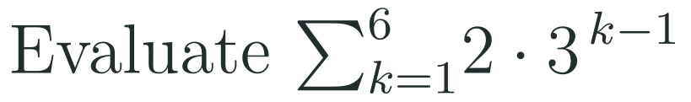
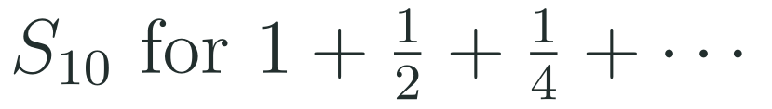
1
2
3
4
5
6
STATION 3 · PRACTICE · 12 MIN
Give it a go: Practice, Apply, Investigate
PRACTICE
APPLY
INVESTIGATE
Secure the method
Use it in context
Find out why
Done when: the ratio is found by dividing consecutive terms, and each formula reproduces the first three terms when you substitute the term numbers 1, 2 and 3.
Done when: the number of steps between the two given terms is shown, and the sum names the first term, the ratio and the number of terms before the formula is used.
Done when: you explain why the sum formula fails when the ratio is 1, and you say what value the partial sums of the second series approach, supported by at least three partial sums.
HSA.SSE.B.4 · HSF.IF.A.3 · HSF.BF.A.2 · HSF.LE.A.2
FAITH, RIGHTEOUSNESS AND WISDOM
Mr Malek Thiab · 9
Notes:
Speaker notes (Practice, 12 min; tierless differentiation: students choose the starting column and may move across):
Answers. Practice 1: r = 12/4 = 3; a_6 = 4 x 3^5 = 4 x 243 = 972. Practice 2: r = 40/80 = 1/2, so a_n = 80 (1/2)^(n-1); check: n = 1, 2, 3 give 80, 40, 20. Apply 1: from term 3 to term 6 is 3 steps: r^3 = 486/18 = 27, r = 3; a_1 = a_3 / r^2 = 18/9 = 2. Check: 2, 6, 18, 54, 162, 486. Apply 2: a_1 = 2, r = 3, n = 6: S_6 = 2(1 - 729)/(1 - 3) = 2(-728)/(-2) = 728. Check: 2 + 6 + 18 + 54 + 162 + 486 = 728. Investigate 1: with r = 1 the denominator 1 - r = 0, so the formula divides by zero and is undefined (this is why HSA.SSE.B.4 says 'when the common ratio is not 1'); every term is 5, so S_n = 5n. Investigate 2: a_1 = 1, r = 1/2: S_10 = (1 - (1/2)^10)/(1 - 1/2) = 2(1 - 1/1024) = 1023/512, about 1.998. Partial sums 1, 1.5, 1.75, 1.875, ... get closer and closer to 2 but never reach it, because (1/2)^n gets close to 0. Verbal misconceptions: Practice 1 using a_6 = 4 x 3^6 = 2916; Practice 2 writing r = 2 or r = -40; Apply 1 using r^4 or r = 9; Apply 2 answering 1458 (the 7th term) or forgetting the minus signs cancel; Investigate 2 'the sum grows without limit because we keep adding'. Adaptive routing: if >30% miss Practice 1, route to slide 5 Example A; Practice 2 or Apply 1, slide 6 Examples A and B; Apply 2, slide 8 Example A; Investigate 1, slide 8 rules; Investigate 2, slide 7 Example C. Students who finish Apply early move to Investigate.

Slide 10

1
2
3
4
5
6
STATION 4 · PRODUCTION · 12 MIN
Production: Jeddah greening programme
THE MODEL
DONE WHEN
Vision 2030 sets targets for greening Saudi cities. A model Jeddah neighbourhood programme (model values only, not real data) plants 256 trees in month 1, and each month it plants 1.5 times as many trees as the month before. Each sapling costs a model 25 SAR.
Both formulas are written, and month 6 gives 1 944 trees.
The 6-month total is 5 320 trees, checked by adding the six terms.
The cost is 133 000 SAR, written with units.
Month 8 is justified: the total is 8 236 after month 7 and 12 610 after month 8.
Write the recursive and explicit formulas, and find the number of trees planted in month 6.
Use the sum formula to find the total planted in the first 6 months and its cost in SAR.
Find the first month in which the running total passes 10 000 trees; check with the totals for the month before and that month.
Hint for solving: name the first term, the ratio and the number of months first; for Task 3 make a table of running totals, or set the sum formula greater than 10 000.
HSA.SSE.B.4 · HSF.IF.A.3 · HSF.BF.A.2 · HSF.LE.A.2
FAITH, RIGHTEOUSNESS AND WISDOM
Mr Malek Thiab · 10
Notes:
Speaker notes (Production, 12 min):
Model values only, not real data. Task 1: recursive a_1 = 256, a_n = 1.5 a_(n-1); explicit a_n = 256 (1.5)^(n-1). Month 6: a_6 = 256 x 1.5^5 = 256 x 7.59375 = 1944 trees. Terms: 256, 384, 576, 864, 1296, 1944. Task 2: S_6 = 256(1 - 1.5^6)/(1 - 1.5) = 256(1 - 11.390625)/(-0.5) = 512 x 10.390625 = 5320 trees; check: 256 + 384 + 576 + 864 + 1296 + 1944 = 5320. Cost: 5320 x 25 = 133 000 SAR. Task 3: S_n = 512(1.5^n - 1). S_7 = 512 x 16.0859375 = 8236 (below 10 000); S_8 = 512 x 24.62890625 = 12 610 (above). So the running total first passes 10 000 in month 8. With logarithms (Lesson 6-6): 1.5^n > 10000/512 + 1 = 20.53, n > ln(20.53)/ln(1.5) = 7.45, so n = 8. Verbal misconceptions: using 1.5^6 for the month-6 term (off by one: that is 2916, the 7th term); answering Task 2 with the month-6 term instead of the total; dividing by 1 - 1.5 = 0.5 instead of -0.5 (sign error gives a negative total); rounding n = 7.45 down to 7. Adaptive routing: if >30% cannot start Task 1, go back to slide 6 Example A; if >30% miss Task 2, slide 8 Example A; if >30% miss Task 3, slide 8 Example C and the table of partial sums on slide 7. Early finishers: the model cost of the first 8 months (12 610 x 25 = 315 250 SAR), and why the model cannot continue for years (month 20 alone would need over 560 000 trees).

Slide 11
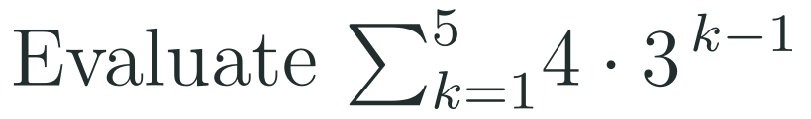
1
2
3
4
5
6
STATION 5 · MASTERY GATE · 6 MIN
Mastery Gate: three questions to pass
1
2
3
Pass mark
3 of 3 correct unlocks Station 6. Fewer than that: return to the slide for the question you missed, redo it, then re-take the gate.
HSA.SSE.B.4 · HSF.IF.A.3 · HSF.BF.A.2 · HSF.LE.A.2
FAITH, RIGHTEOUSNESS AND WISDOM
Mr Malek Thiab · 11
Notes:
Speaker notes (Mastery Gate, 6 min, no calculator):
Answers. Q1: find r first: r = -48/96 = -1/2; next term 24 x (-1/2) = -12. Q2: write the explicit formula first: a_n = 7 x 2^(n-1); a_6 = 7 x 2^5 = 7 x 32 = 224. Check: 7, 14, 28, 56, 112, 224. Q3: a_1 = 4, r = 3, n = 5: S_5 = 4(1 - 243)/(1 - 3) = 4(-242)/(-2) = 484. Check: 4 + 12 + 36 + 108 + 324 = 484. Verbal misconceptions: Q1 giving r = -2 (dividing the wrong way) or next term 12 (dropping the sign); Q2 using 2^6 and giving 448; Q3 giving 972 (the 6th term) or 324 (the last term only), or 4(3^5) = 972. Adaptive routing: Q1 missed, route to slide 5 (block 1); Q2 missed, route to slide 6 (block 2); Q3 missed, route to slide 7 (block 3, the meaning of the sum) and slide 8 (block 4, using the formula). If a student misses two or more, they join the teacher group for the Smart Production create step; students who get all three correct start the create step immediately.

Slide 12
1
2
3
4
5
6
STATION 6 · SMART PRODUCTION · 6 MIN
Smart Production: make one, then check it
CREATE
TIME TO CHECK
Invent a geometric sequence with a real context: give the first term, the ratio and what the term number counts.
Write its recursive and explicit formulas and the sum of its first 5 terms.
Swap with a partner: check their sum by adding the five terms.
Exit ticket: write your answer on a sticky note and place it on the door.
Done when: your sequence has a constant ratio that is not 1, both formulas give the same first three terms, and your partner's addition matches your formula.
Next lesson: 9-1 Parabolas.
HSA.SSE.B.4 · HSF.IF.A.3 · HSF.BF.A.2 · HSF.LE.A.2
FAITH, RIGHTEOUSNESS AND WISDOM
Mr Malek Thiab · 12
Notes:
Speaker notes (Smart Production, 6 min):
Worked solutions. Exit 1: a_1 = 3, r = 2, n = 6: S_6 = 3(1 - 64)/(1 - 2) = 3(-63)/(-1) = 189. Check: 3 + 6 + 12 + 24 + 48 + 96 = 189. Exit 2: a_n = 1000 x 0.8^(n-1); a_5 = 1000 x 0.8^4 = 1000 x 0.4096 = 409.6. Check: 1000, 800, 640, 512, 409.6. Create step: a good context is a quantity multiplied by the same factor each step (savings growing by a fixed percent, a bouncing ball reaching 3/4 of its height). Make sure students write r as a factor (1.1 for a 10 percent rise, not 0.1). Verbal misconceptions: Exit 1 answering 96 (the 6th term) or 192 (a_1 r^6); Exit 2 using 0.8^5 = 327.68 (off by one) or subtracting 0.8 each time. Adaptive routing: if >30% miss Exit 1, open the next lesson with a 5-minute retrieval of slide 8 Example A; if >30% miss Exit 2, retrieve slide 6 Example C.

Slide 13
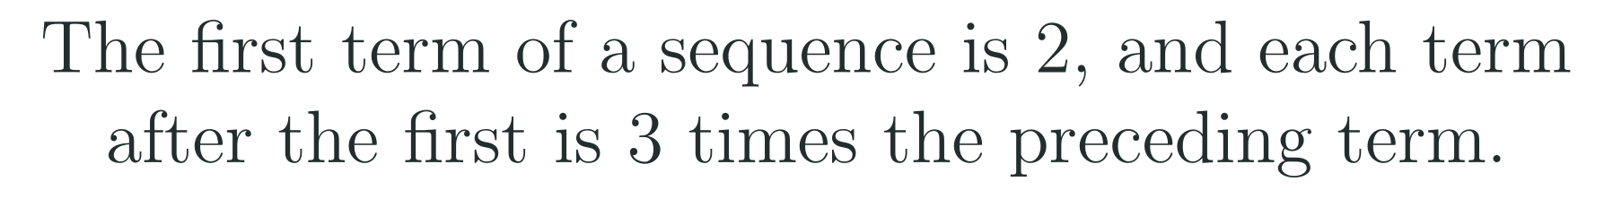
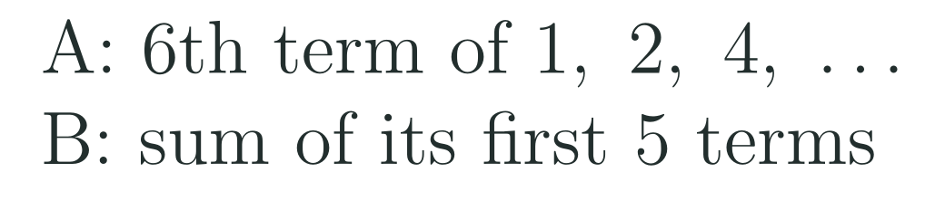

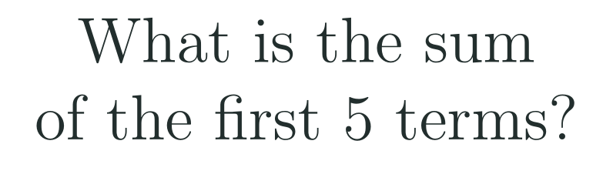

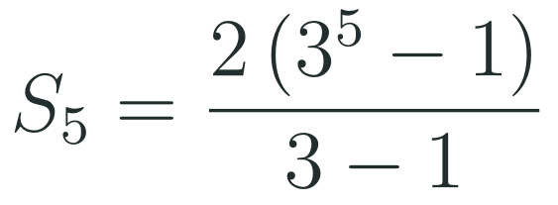

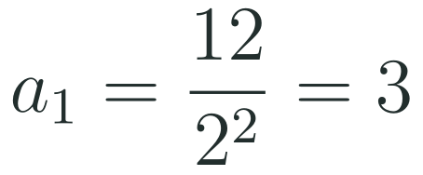


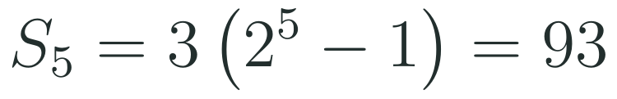
Exam connections
SAT
GAT
SAAT
STEPS
STEPS
STEPS
1
1
1
2
2
2
3
3
3
HSA.SSE.B.4 · HSF.IF.A.3 · HSF.BF.A.2 · HSF.LE.A.2
FAITH, RIGHTEOUSNESS AND WISDOM
Mr Malek Thiab · 13
Notes:
Speaker notes: each exam item is worked in numbered steps.
SAT (Advanced Math, global style, no context needed): a_1 = 2, r = 3, n = 5. S_5 = 2(3^5 - 1)/(3 - 1) = 2(242)/2 = 242. Check by listing: 2 + 6 + 18 + 54 + 162 = 242. Verbal misconceptions (the traps): choosing 162 (the 5th term, a partial step) or 486 (2 x 3^5, using r^n); a student-produced-response grid answer is 242. GAT/Qudurat quantitative comparison (A is greater / B is greater / they are equal / cannot be determined): A is the 6th term 1 x 2^5 = 32; B = 1 + 2 + 4 + 8 + 16 = 31 (or 2^5 - 1). A is greater. Trap: assuming they are equal, or taking the 6th term as 2^6 = 64. Structure to notice: for r = 2 the sum of all earlier terms is always one less than the next term. SAAT/Tahsili (multiple choice, four options): from term 3 to term 6 is 3 steps, r^3 = 8, r = 2; a_1 = a_3 / r^2 = 12/4 = 3; S_5 = 3(2^5 - 1)/(2 - 1) = 93. Check: 3 + 6 + 12 + 24 + 48 = 93. Trap: r^4 = 8 or r = 4 (counting terms, not steps), or a_1 = 6 (dividing by r once). Adaptive routing: if >30% miss the SAT item, return to slide 8 Example A; the GAT item, slide 7 Example B; the SAAT item, slide 6 Example B and then slide 8.

Slide 14
Journey complete
Targeted Instruction
Production
Smart Production
✓
✓
✓
✓
✓
✓
Diagnose
Practice
Mastery Gate
A geometric sequence multiplies by a constant ratio; a geometric series adds its terms, and when the ratio is not 1 the sum has a closed formula.
FAITH, RIGHTEOUSNESS AND WISDOM
Notes:
Speaker notes: Every station is checked off. Recap in one sentence: A geometric sequence multiplies by a constant ratio; a geometric series adds its terms, and when the ratio is not 1 the sum has a closed formula. Collect the Time to Check responses. Next lesson: 9-1 Parabolas.

